Slide 1
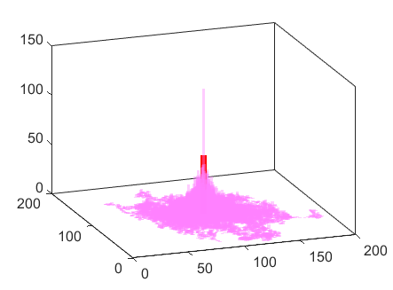
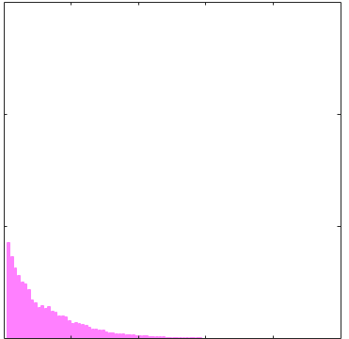
Fig. S4 –Model 2 – Lck activation (LA) – Model + MC simulations
A
random walk and activation
B
Active LCK distribution
C
Radial density of active LCK
150
active
LCK
100
Activation
By CD45
Counts
Radial density
50
Spontaneous
deactivation
inactive
LCK
Y(nm)
0
X(nm)
0
500
1000
r(nm)

Slide 2
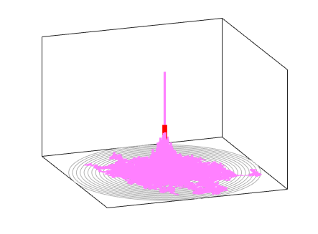
Fig. S4 –Model 2 – Lck activation (LA) – Model + MC simulations
A
random walk and activation
B
C
Radial density of active LCK
150
active
LCK
100
Activation
By CD45
Counts
Radial density
1000
50
Spontaneous
deactivation
inactive
LCK
0
y(nm)
-1000
-1000
0
1000
0
x(nm)
0
500
1000
r(nm)

